Slide 1
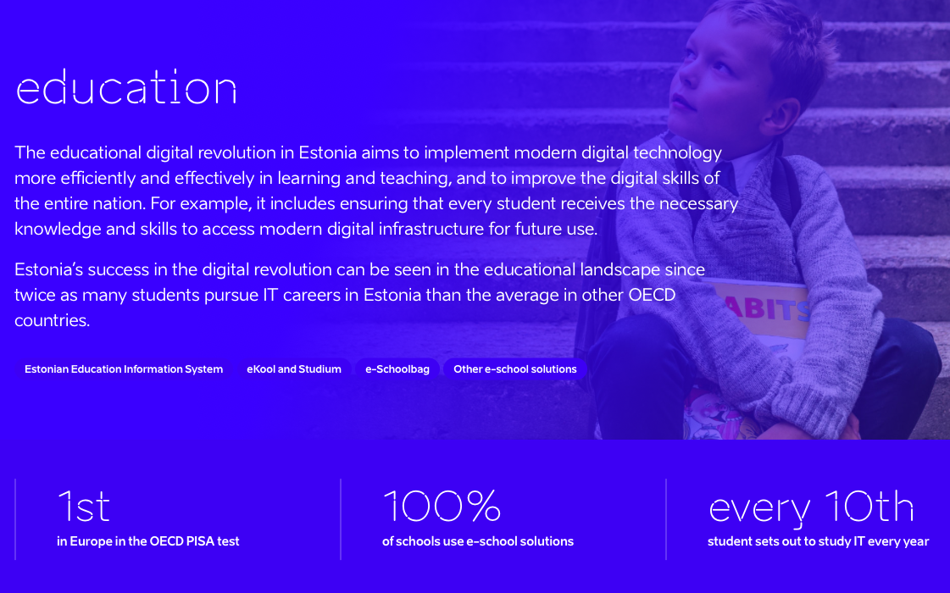

Slide 2
The Tiger Leap Program was launched in 1996 by Toomas Hendrik Ilves, Jaak Aaviksoo and Lennart Georg Meri. 3 pillars — computers and the Internet, basic teacher training and native-language electronic courseware for general education institutions. Tiger Leap Foundation - 1997. All schools were provided with computers by 2000 and by the year 2001, all schools were connected to the Internet. The local governments, received financial support from Tiger Leap equal to what they could invest themselves. Basic ICT courses for teachers were organized – in 1997 nearly 4000 teachers participated in the 40-hour computer basic training course, with thousands more in the next years. In 1999, new courses in electronic courseware, online information searches and preparation of educational materials were introduced. In 2000, the Estonian Information Technology Foundation was established

Slide 3
Tiger Leap Plus
ICT competences of students, teachers and educational staff. Its main activities included the creation of electronic educational materials, in-service training and support of teacher cooperation and experience exchanges
Estonian e-Vocational School consortium, with the aim of developing e-learning and cooperation in vocational education
Estonian e-University consortium - diversification of higher education and the development of more flexible learning opportunities in institutions of higher education
Learning Tiger program - make e-learning a natural part of daily tutorial work, curricula and teacher training. Web-based learning management system and new learning environments (Moodle, VIKO), further developing teachers’ ICT competencies, competitions for students and taking part in international cooperation through programs like eTwinning and Smartly on the Web.
DigiTiger, ScienceTiger, TigerRobotics, SewingTiger, TechnoTiger, AnimaTiger, TigerMath, VanKER (e-VET, almost all VET teachers participated).

Slide 4
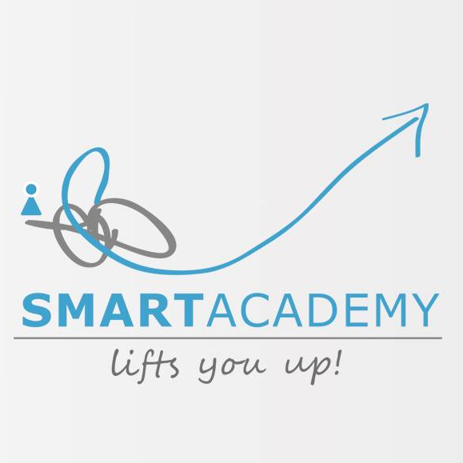
SmartAcademy
2,5-hour smart device and e-services training seminars in libraries all across Estonia.
ABC of smart devices (what is mobile data, what are applications, how to do a Google-search, how to use e-mail on a smart device etc) and how to use smart devices safely.
Test of smart device skills based on the DigiComp framework

Slide 5
Look@World
Basic computer training for 102 697 people (10% of the adult population of Estonia)
11 693 courses organised
8 hour basic computer and internet training course for beginners free of charge
280 part-time educators who worked in 245 training classes were engaged
more than 70% of the participants started using the Internet
2 years (including the pilot training).

Slide 6
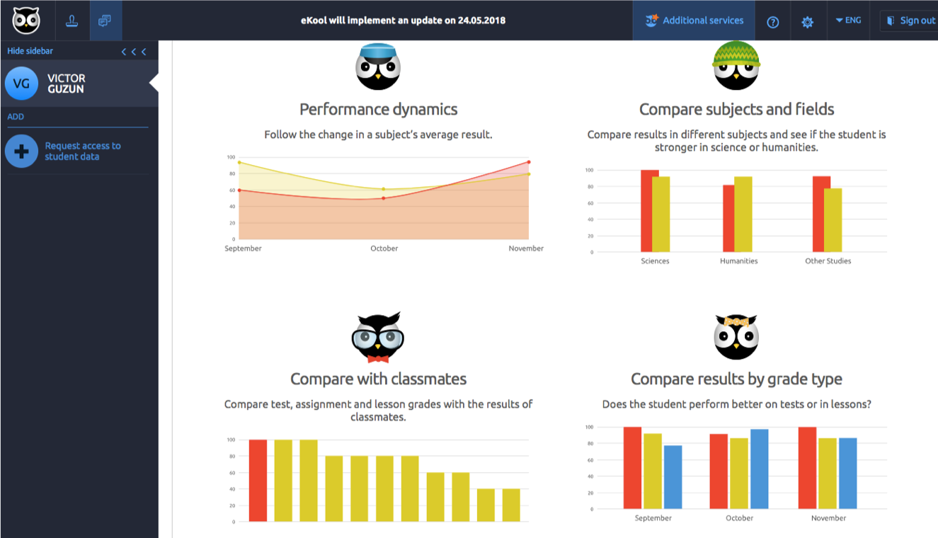
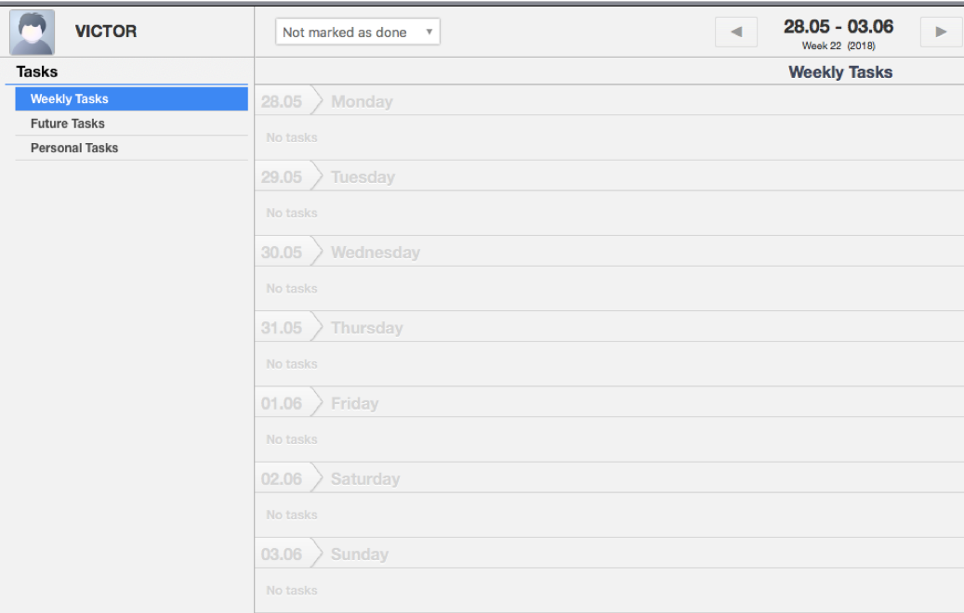
ELIIS, E-School

Slide 22
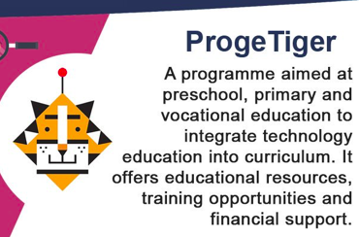
Some examples what our teachers do in schools:
In preschool, teachers teach and use LEGO WeDo, Kodu Game Lab, tablets (apps), programmes to make animations etc.
In primary school, teachers teach and use Kodu Game Lab, Logo MSW, Scratch, LEGO Mindstorms EV3, mobile app making programmes and environments, many different programmes and environments which are used for teaching various subjects (music, mathematic, physics, biology), e-labs etc.
In high school and vocational education, teachers teach and use different programming languages (Python, JavaScript etc), Codecademy.com courses, 3D graphics, robotics, programmes to make games, web-pages and apps etc.

Slide 23
2015
More Estonian school kids interested in technology. They should not be taken back by the fear that technology is only for the smartest or the best
3D printers and tools to Estonian schools
e-Summer schools
encouraging people to form teams that will put people with different skills together
not only STEM (Science, Technology, Education, Mathematics) but STEAM: integrating the arts as well

